Slide 1
Introduction

Slide 2
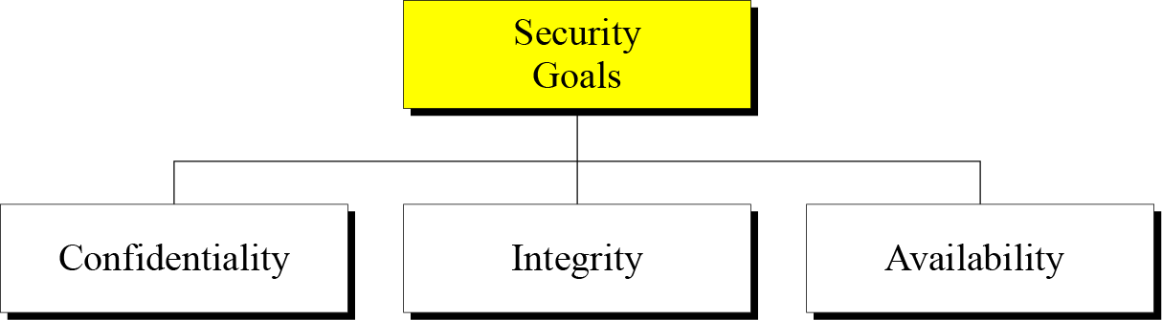
THREE SECURITY GOALS
Taxonomy of security goals

Slide 3
Continued
Confidentiality is probably the most common aspect of information security. We need to protect our confidential information. An organization needs to guard against those
malicious actions that endanger the confidentiality of its information.
Information needs to be changed constantly. Integrity means that changes need to be done only by authorized entities and through authorized mechanisms.
The information created and stored by an organization needs to be available to authorized entities. Information needs to be constantly changed, which means it must be accessible to authorized entities.

Slide 4
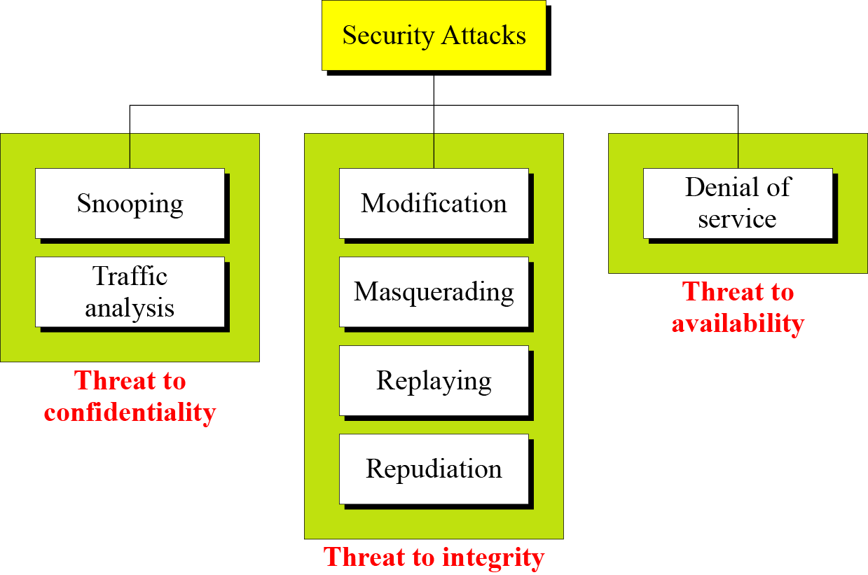
ATTACKS
The three goals of security⎯confidentiality, integrity, and availability⎯can be threatened by security attacks.
Taxonomy of attacks with relation to security goals

Slide 5


Attacks Threatening Confidentiality
Snooping refers to unauthorized access to or interception of data.
e.g. IP spoofing: send packet with false source address
A
C
src:B dest:A payload
B
Traffic analysis refers to obtaining some other type of information by monitoring online traffic.

Slide 6

Attacks Threatening Integrity
Masquerading or spoofing happens when the attacker impersonates somebody else.
Replaying means the attacker obtains a copy
of a message sent by a user and later tries to replay it.
C
A
src:B dest:A user: B; password: foo
B

Slide 7
Attacks Threatening Integrity
Masquerading or spoofing happens when the attacker impersonates somebody else.
Replaying means the attacker obtains a copy
of a message sent by a user and later tries to replay it.
later …..
C
A
src:B dest:A user: B; password: foo
B

Slide 8
Attacks Threatening Integrity
Modification means that the attacker intercepts the message and changes it.
Repudiation means that sender of the message might later deny that she has sent the message; the receiver of the message might later deny that he has received the message.

Slide 9
Attacks Threatening Availability
Denial of service (DoS) is a very common attack. It may slow down or totally interrupt the service of a system.
attackers make resources (server, bandwidth) unavailable to legitimate traffic by overwhelming resource with bogus traffic
select target
break into hosts around the network
send packets toward target from compromised hosts
target

Slide 10
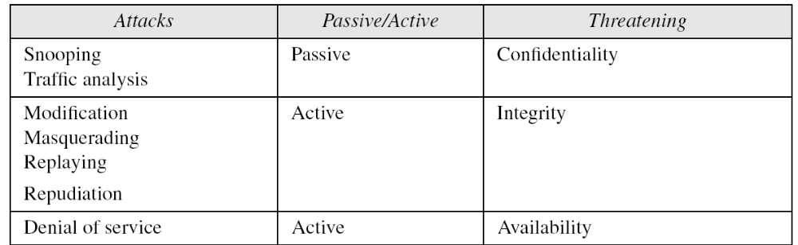
Passive Versus Active Attacks
Categorization of passive and active attacks
In a passive attack, the attacker’s goal is just to obtain information. The attack does not modify data or harm the system, and the system continues with its normal operation.
An active attack may change the data or harm the system.

Slide 11
OSI Security Architecture
OSI security Architecture consist of
Security Attacks
Security Services
Security Mechanism

Slide 12
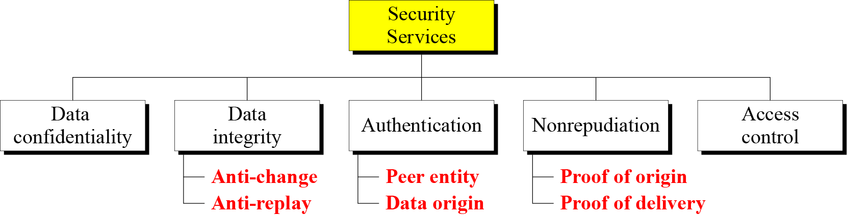
Security Services
Data confidentiality protects data from disclosure attack.
Data integrity protect data from modification, insertion, deletion, and replaying attacks.
Authentication provides proof of sender, or receiver, or source of the data.
Nonrepudiation protects against repudiation by either the sender to the reveiver.
Access control provides protection again unauthorized access to data.

Slide 13
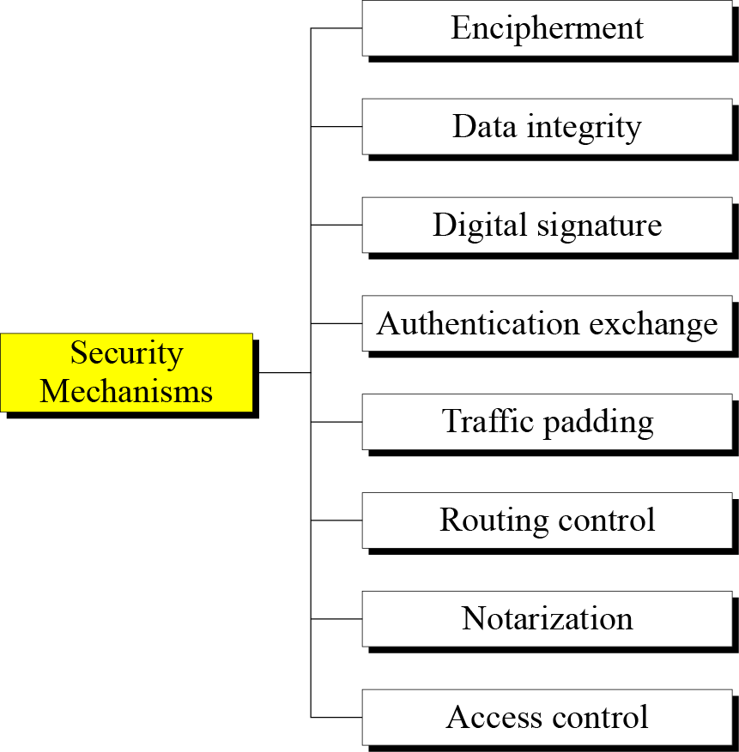
Security Mechanism
Hiding or covering data
Appends to data a short check value
Sender signs data, receiver verifies data
Two entities exchange msg to prove their identity to each other
Insert bogus data into the data traffic to thwart traffic analysis
Continuously change routes b/w sender and receiver to prevent eavesddropping
A third trusted party controls communication
Prove and verify that a user has access right to resources

Slide 14
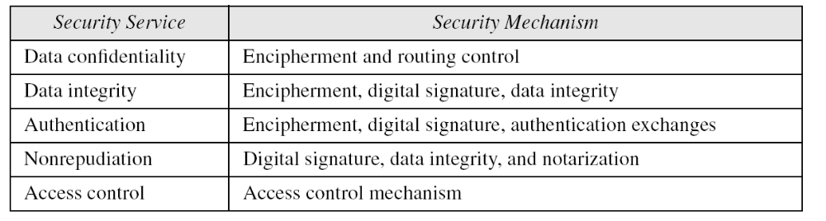
Relation between Services and Mechanisms
Relation between security services and mechanisms

Slide 15
TECHNIQUES
Cryptography
Steganography

Slide 16
Cryptography
Cryptography, a word with Greek origins, means “secret writing.” However, we use the term to refer to the science and art of transforming messages to make them secure and immune to attacks.
Cryptanalysis: the art and science of decrypting messages.
Cryptology: cryptography + cryptanalysis

Slide 17
STEGANOGRAPHY
Steganography is the art and science of hiding information into covert channels so as to conceal the information and prevent the detection of the hidden message.
Today, steganography refers to hiding information in digital picture files and audio files.

Slide 18
STEGANOGRAPHY
Hide a message by using the least significant bits of frames on a CD
Kodak photo CD format’s maximum resolution is 2048 by 3072 pixels, with each pixel containing 24 bits of RGB color information.
The least significant bit of each 240bit pixel can be changed without greatly affecting the quality of the image.
Drawbacks:
  Overhead
  Worthless once discovered (encryption)

Slide 19

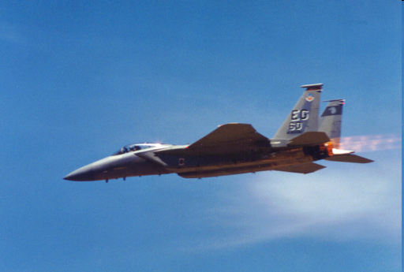
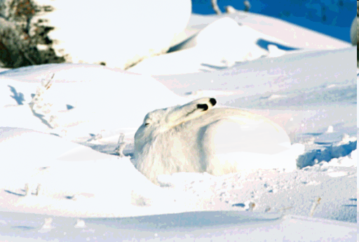
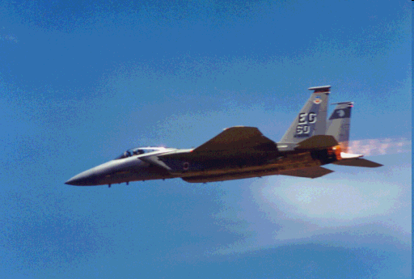
The image in which we want to hide another image
The image we wish to hide: ‘F15’
The stego-image (i.e., after the hiding process)
The image extracted from the stego-image

Slide 20
Traditional
Symmetric-Key Ciphers

Slide 21
CLASSICAL ENCRYPTION TECHNIQUES
Goals:
  To introduce basic concepts & terminology of encryption
  To prepare us for studying modern cryptography

Slide 22
BASIC TERMINOLOGY
Plaintext: original message to be encrypted
Cipher-text: the encrypted message
Enciphering or encryption: the process of converting
plaintext into cipher-text
Encryption algorithm: performs encryption
  Two inputs: a plaintext and a secret key
Deciphering or decryption: recovering plaintext from cipher-text
Decryption algorithm: performs decryption
  Two inputs: cipher-text and secret key

Slide 23
BASIC TERMINOLOGY
Secret key: same key used for encryption and decryption
  Also referred to as a symmetric key
Cipher or cryptographic system : a scheme for encryption and decryption
Cryptography: science of studying ciphers
Cryptanalysis: science of studying attacks against cryptographic systems
Cryptology: cryptography + cryptanalysis

Slide 24
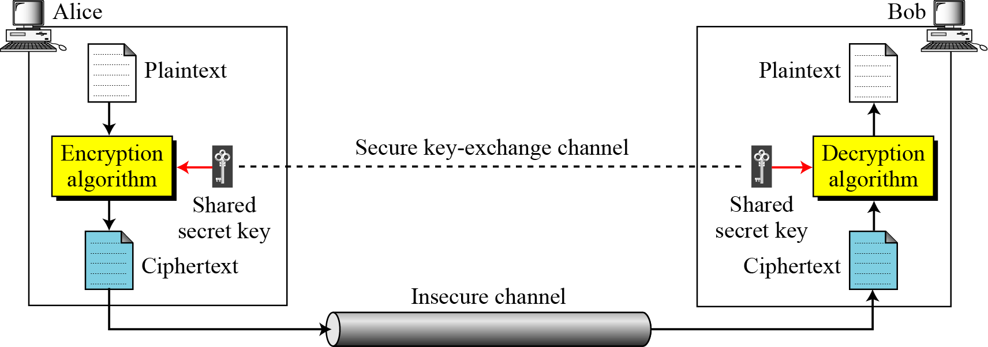
INTRODUCTION
General idea of symmetric-key cipher
The original message from Alice to Bob is called plaintext; the message that is sent through the channel is called the ciphertext. To create the ciphertext from the plaintext, Alice uses an encryption algorithm and a shared secret key. To create the plaintext from ciphertext, Bob uses a decryption algorithm and the same secret key.

Slide 25
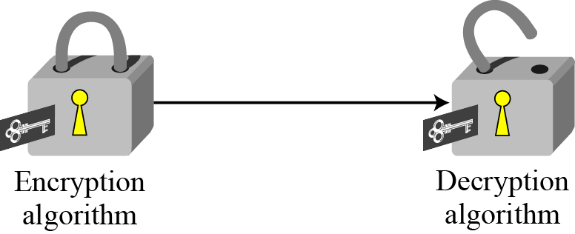
Continued
Locking and unlocking with the same key

Slide 26
Kerckhoff’s Principle
Based on Kerckhoff’s principle, one should always assume that the adversary, Eve, knows the encryption/decryption algorithm. The resistance of the cipher to attack must be based only on the secrecy of the key.

Slide 27
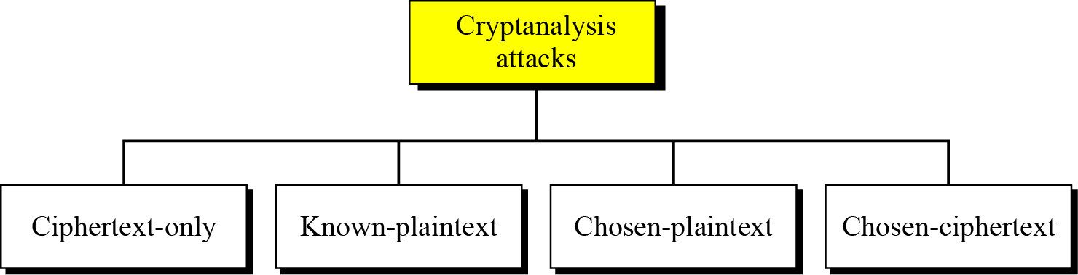
Cryptanalysis
As cryptography is the science and art of creating secret codes, cryptanalysis is the science and art of breaking those codes.
Cryptanalysis attacks

Slide 28
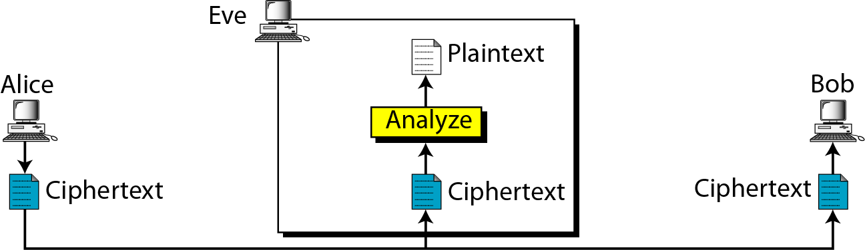
Ciphertext-Only Attack
Ciphertext + algorithm → key and the plaintext
Brute-Force attack: exhaustive key search attack
Statistical attack: benefit from inherent characteristics of the plaintext language. E.g. E is the most frequently used letter.
Pattern attack: discover pattern in ciphertext.

Slide 29
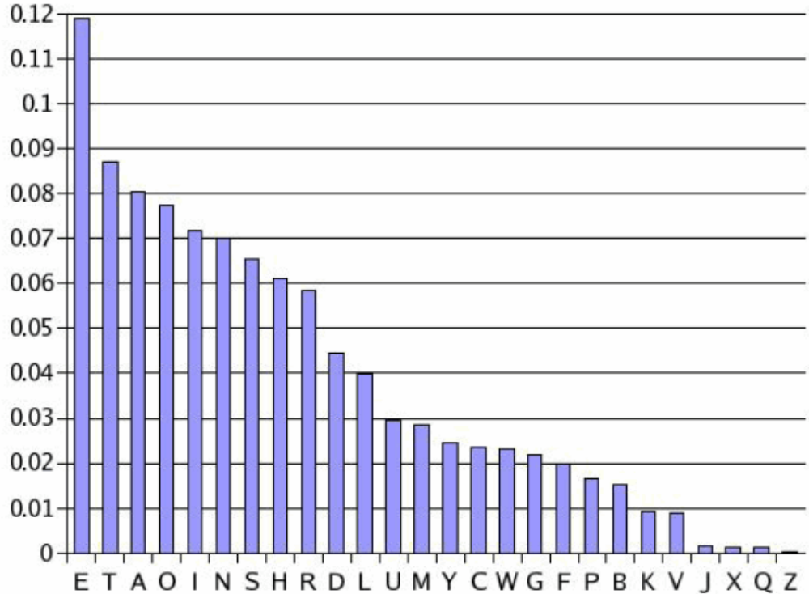
STATISTICAL ATTACK : FREQUENCY OF CHARACTERS IN ENGLISH

Slide 30
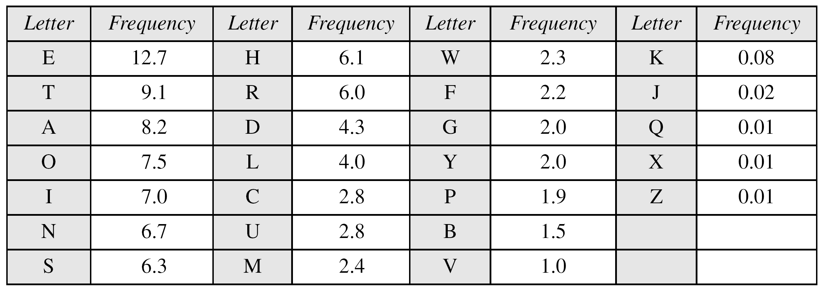
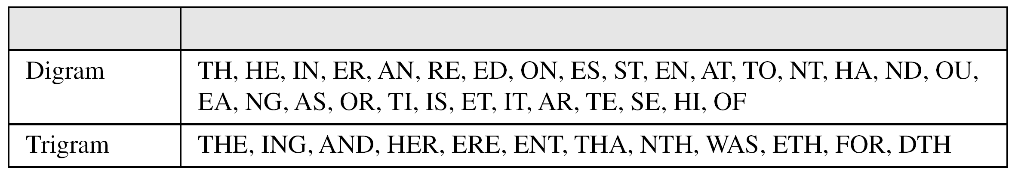
Continued
Frequency of characters in English
Frequency of diagrams and trigrams

Slide 31
Continued
Eve has intercepted the following ciphertext. Using a statistical attack, find the plaintext.
Solution
When Eve tabulates the frequency of letters in this ciphertext, she gets: I =14, V =13, S =12, and so on. The most common character is I with 14 occurrences. This means key = 4 because the distance b/w e and I is 4 (e.f.g.h.i).

Slide 32
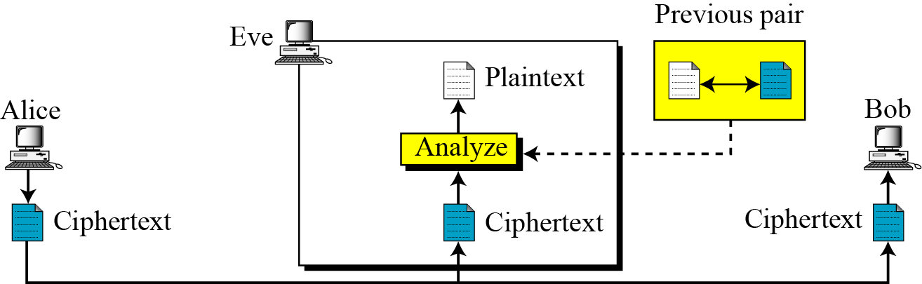
Known-plaintext attack
Eve has access to some plaintext/ciphertext pairs in addition to the intercepted ciphertext.
Eve uses the relationship b/w the previous pair to analyze the current ciphertext.

Slide 33
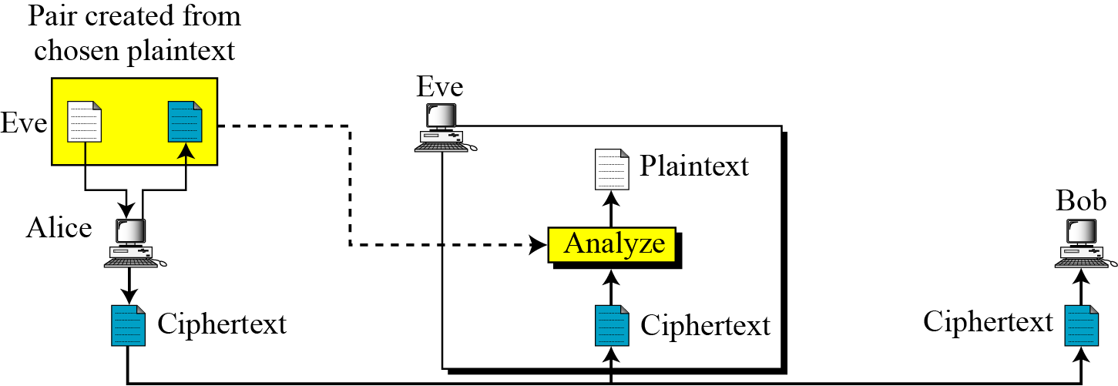
Chosen-plaintext attack
The plaintext/ciphertext pairs have been chosen by the attacker herself.

Slide 34
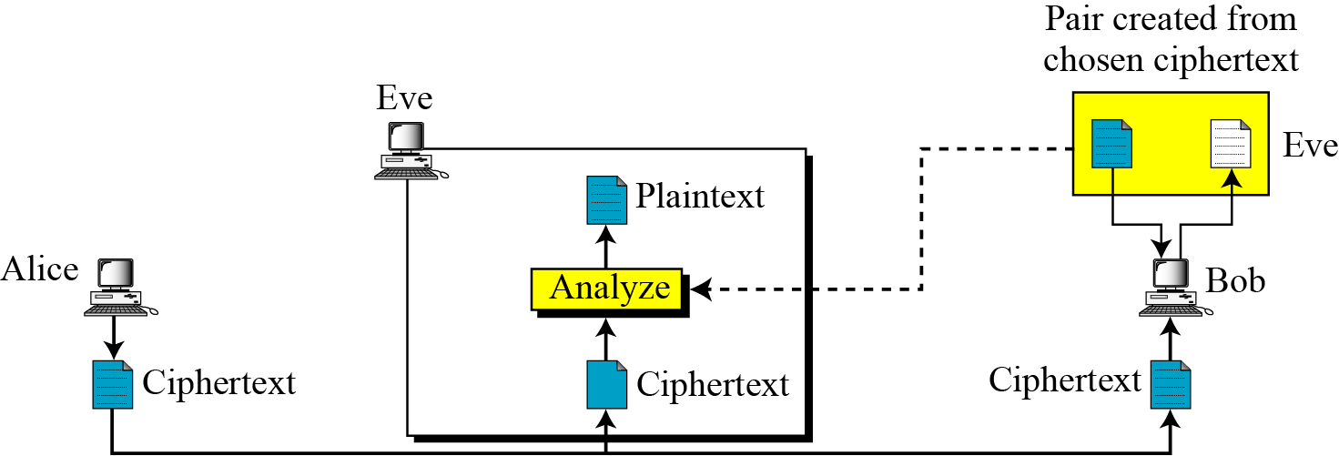
Chosen-ciphertext attack
Eve chooses some ciphertext and decrypts to form a ciphertext/plaintext pair. This can happen if Eve has access to Bob’s computer.

Slide 35
SUBSTITUTION CIPHERS
A substitution cipher replaces one symbol with another.
It can be categorized as either mono alphabetic ciphers or polyalphabetic ciphers

Slide 36
Monoalphabetic Ciphers
In monoalphabetic substitution, the relationship between a symbol in the plaintext to a symbol in the ciphertext is always one-to-one.

Slide 37
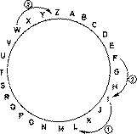
Monoalphabetic Ciphers, Shift Cipher, Addictive Cipher
replace letters of a message by other distinct letters a fixed distance away
Famous shift cipher: Caesar Cipher
  Shift by 3 letters
  reputedly used by Julius Caesar (100 – 44 B.C.)
Plaintext: I CAME I SAW I CONQUERED
Ciphertext: L FDPH L VDZ L FRQTXHUHG

Slide 38
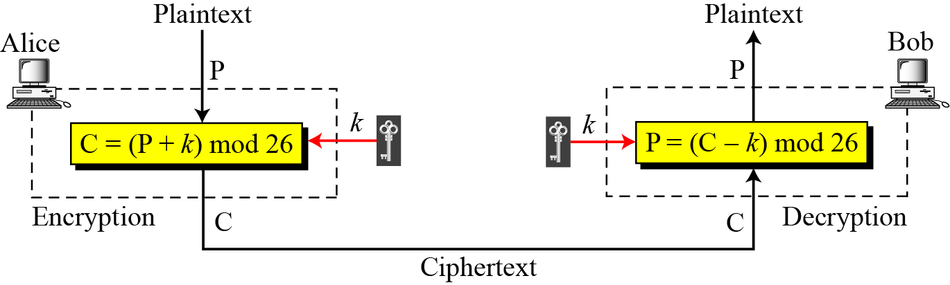
Additive cipher
When the cipher is additive, the plaintext, ciphertext, and key are integers in Z₂₆.

Slide 39
Additive Cipher
The simplest monoalphabetic cipher is the additive cipher. This cipher is sometimes called a shift cipher and sometimes a Caesar cipher, but the term additive cipher better reveals its mathematical nature.
A shift cipher can also be described as
Encryption EK(x) = x + K mod 26
Decryption DK(x) = x - K mod 26
for English alphabet by setting up a correspondence
between alphabetic characters and residues modulo 26.
  _{K=3 in Caesar Cipher.}

Slide 40
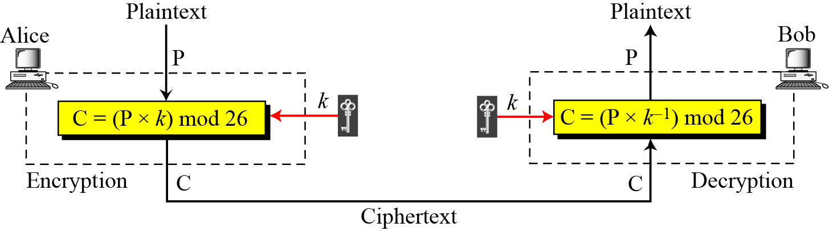
Multiplicative Ciphers
In a multiplicative cipher, the plaintext and ciphertext are integers in Z₂₆; the key is an integer in Z26*.

Slide 41
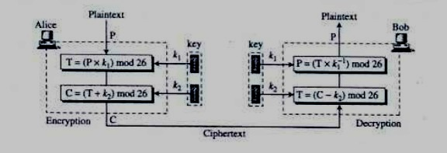
AFFINE CIPHER
The cipher that we get after combining additive and multiplicative ciphers is called affine cipher.

Slide 42
Monoalphabetic Substitution Cipher
Because additive, multiplicative, and affine ciphers have small key domains, they are very vulnerable to brute-force attack.
A better solution is to create a mapping between each plaintext character and the corresponding ciphertext character. Alice and Bob can agree on a table showing the mapping for each character.
An example key for monoalphabetic substitution cipher

Slide 43
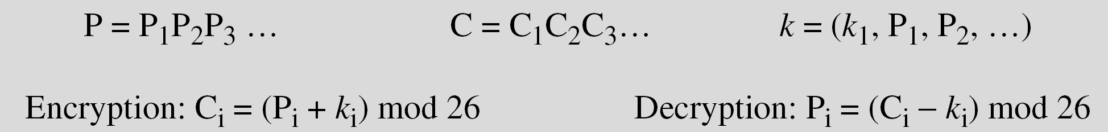
Polyalphabetic Ciphers
In polyalphabetic substitution, each occurrence of a character may have a different substitute. The relationship between a character in the plaintext to a character in the ciphertext is one-to-many.
Autokey Cipher

Slide 44
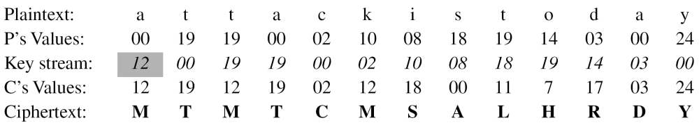
Example Auto Key Cipher
Assume that Alice and Bob agreed to use an autokey cipher with initial key value k1 = 12. Now Alice wants to send Bob the message “Attack is today”. Enciphering is done character by character.
Cryptoanalysis
Advantages : Hides the single-letter frequency statistics of the plain-text.
Disadvantages: Vulnerable to brute-force attack as additive cipher because .

Slide 45
TRANSPOSITION CIPHERS

Slide 46
TRANSPOSITION CIPHERS
A transposition cipher does not substitute one symbol for another, instead it changes the location of the symbols.
Keyless Transposition Ciphers
Keyed Transposition Ciphers
Combining Two Approaches

Slide 47
Keyless Transposition Ciphers
Simple transposition ciphers, which were used in the past, are keyless.
Example
A good example of a keyless cipher using the first method is the rail fence cipher. The ciphertext is created reading the pattern row by row. For example, to send the message “Meet me at the park” to Bob, Alice writes
She then creates the ciphertext “MEMATEAKETETHPR”.

Slide 48
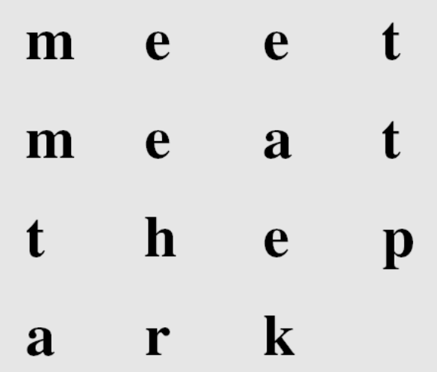
3.3.1 Continued
Example 3.23
Alice and Bob can agree on the number of columns and use the second method. Alice writes the same plaintext, row by row, in a table of four columns.
She then creates the ciphertext “MMTAEEHREAEKTTP”.

Slide 49
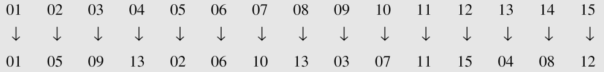
3.3.1 Continued
Example 3.24
The following shows the permutation of each character in the plaintext into the ciphertext based on the positions.
The second character in the plaintext has moved to the fifth position in the ciphertext; the third character has moved to the ninth position; and so on. Although the characters are permuted,
there is a pattern in the permutation: (01, 05, 09, 13), (02, 06, 10, 13), (03, 07, 11, 15), and (08, 12). In each section, the difference between the two adjacent numbers is 4.

Slide 50
3-4 STREAM AND BLOCK CIPHERS
The literature divides the symmetric ciphers into two broad categories: stream ciphers and block ciphers. Although the definitions are normally applied to modern ciphers, this categorization also applies to traditional ciphers.
Topics discussed in this section:
3.4.1 Stream Ciphers
3.4.2 Block Ciphers
3.4.3 Combination

Slide 51
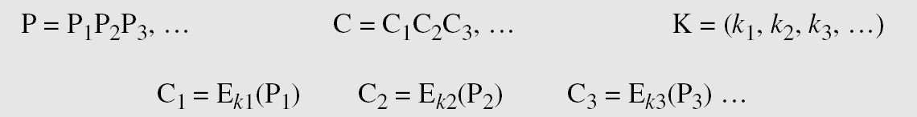
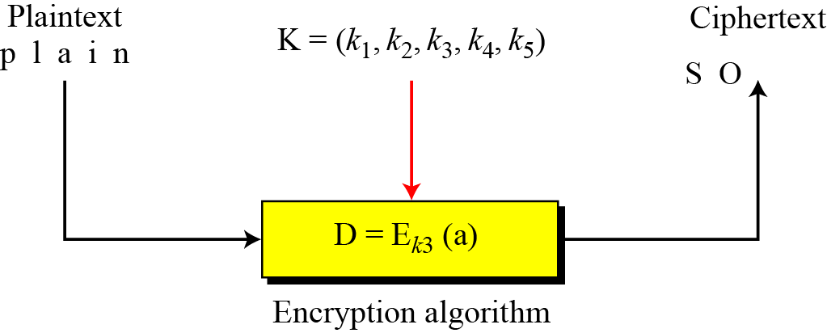
3.4.1 Stream Ciphers
Call the plaintext stream P, the ciphertext stream C, and the key stream K.
Figure 3.26 Stream cipher

Slide 52
3.4.1 Continued
Example 3.30
Additive ciphers can be categorized as stream ciphers in which the key stream is the repeated value of the key. In other words, the key stream is considered as a predetermined stream of keys or
K = (k, k, …, k). In this cipher, however, each character in the ciphertext depends only on the corresponding character in the plaintext, because the key stream is generated independently.
Example 3.31
The monoalphabetic substitution ciphers discussed in this chapter are also stream ciphers. However, each value of the key stream in this case is the mapping of the current plaintext character to the corresponding ciphertext character in the mapping table.

Slide 53
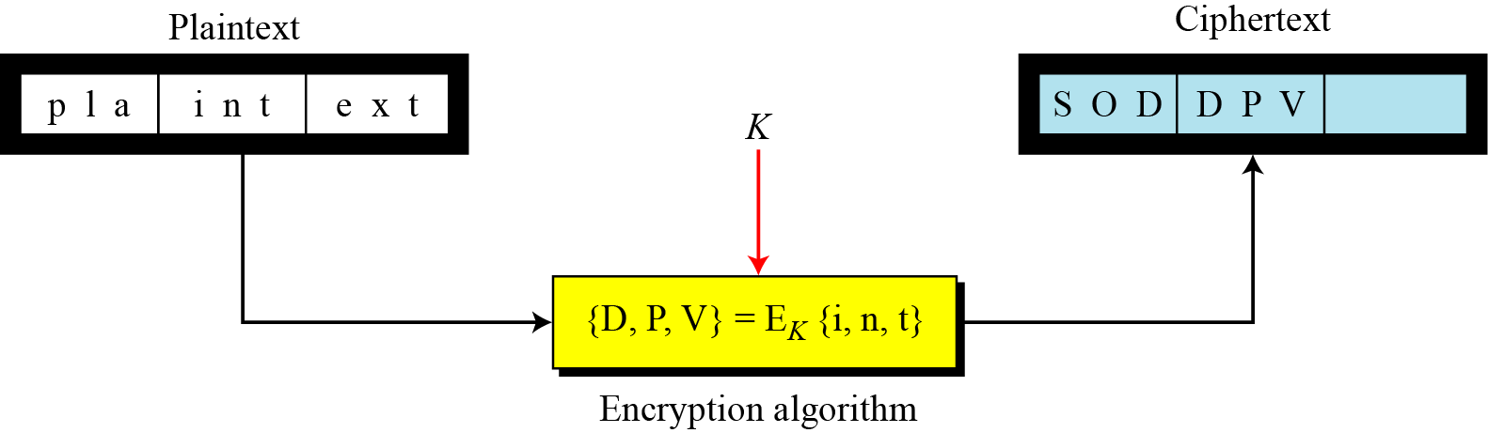
3.4.2 Stream Ciphers
In a block cipher, a group of plaintext symbols of size m (m > 1) are encrypted together creating a group of ciphertext of the same size. A single key is used to encrypt the whole block even if the key is made of multiple values. Figure 3.27 shows the concept of a block cipher.
Figure 3.27 Block cipher

